Slide 1

Music Store Sales Analysis using SQL
Presented By:
Pavan Mirudoddi
Annam Vinay Reddy
Batch No: 456 Location:Dilshuknagar

Slide 2
Agenda
Business Problem
Business Problem Statement
Objective of the Project
Data description
ER Diagram
Key analysis questions (use cases)
SQL query results with screenshots or summaries
Final business insights and recommendations
Challenges Working on SQL Project
Conclusion (Key ﬁnding overall)
Q&A Slide

Slide 3
Business Problem:
The music store collects large volumes of sales, customer, and song purchase data every day. However, this data is stored only for transactions and not properly analyzed to understand which songs, genres, and artists perform best. Because of this, the business struggles to identify customer preferences, top-selling music, and high-revenue markets. This lack of insights leads to ineffective marketing strategies, missed sales opportunities, and poor decision-making.

Slide 4
Business Problem Statement:
The music store needs a structured SQL-based analytical system to examine customer purchases and sales data to determine top-selling songs, popular genres, high-performing artists, and revenue trends. By transforming raw transactional data into meaningful insights, the business can optimize promotions, target the right customers, and improve overall sales performance.

Slide 5
Objective of the Project
The objective of this project is to build a relational SQL database for the Music Store that efficiently manages customer, sales, and music data. The project aims to analyze transactions, identify top customers and popular genres, track revenue trends, and generate actionable insights to support better business decisions.

Slide 6
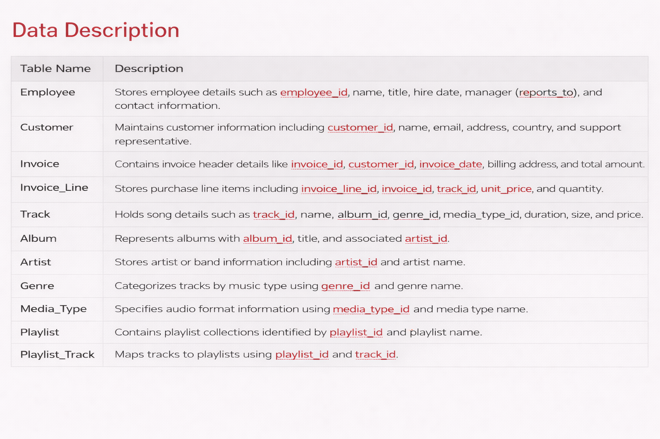

Slide 7
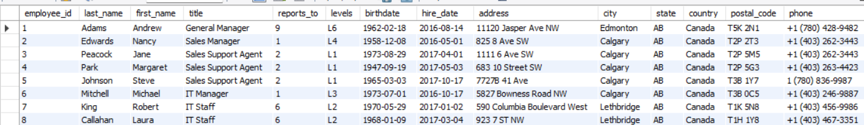
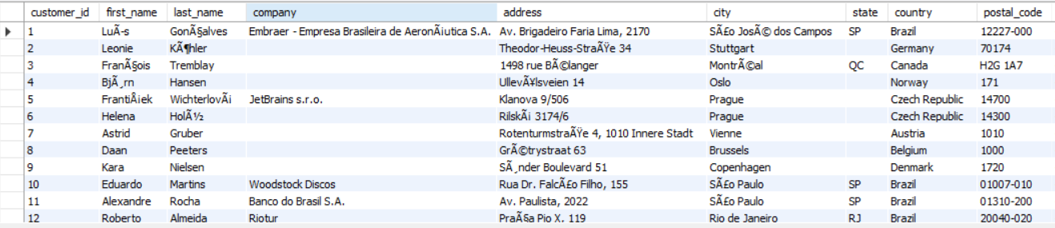
Customer
Employee

Slide 8
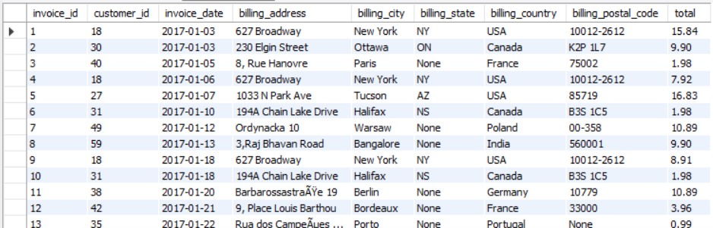
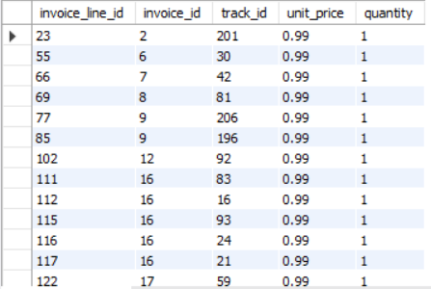
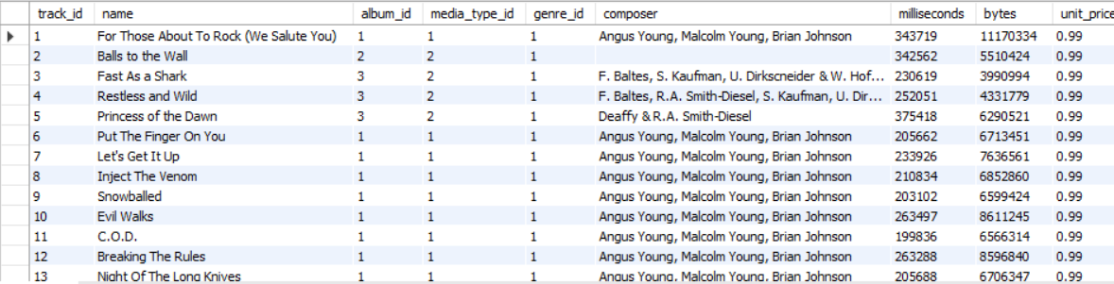
Invoice
Invoiceline
Track

Slide 9
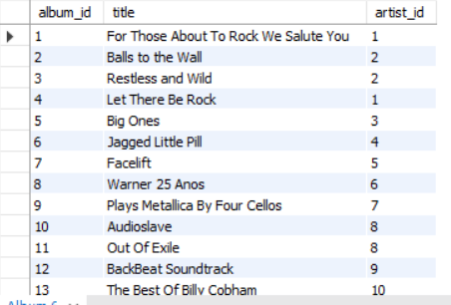
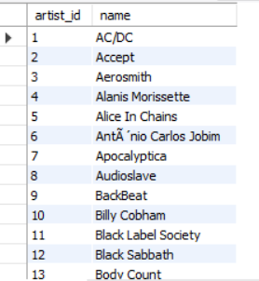
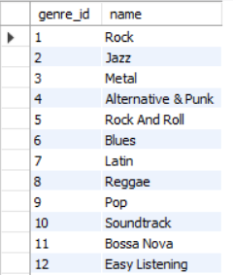
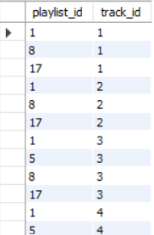
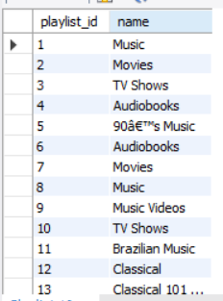
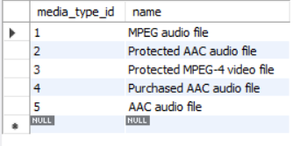
Album
Artist
Genere
Playlisttrack
Playist
Media_Type

Slide 10
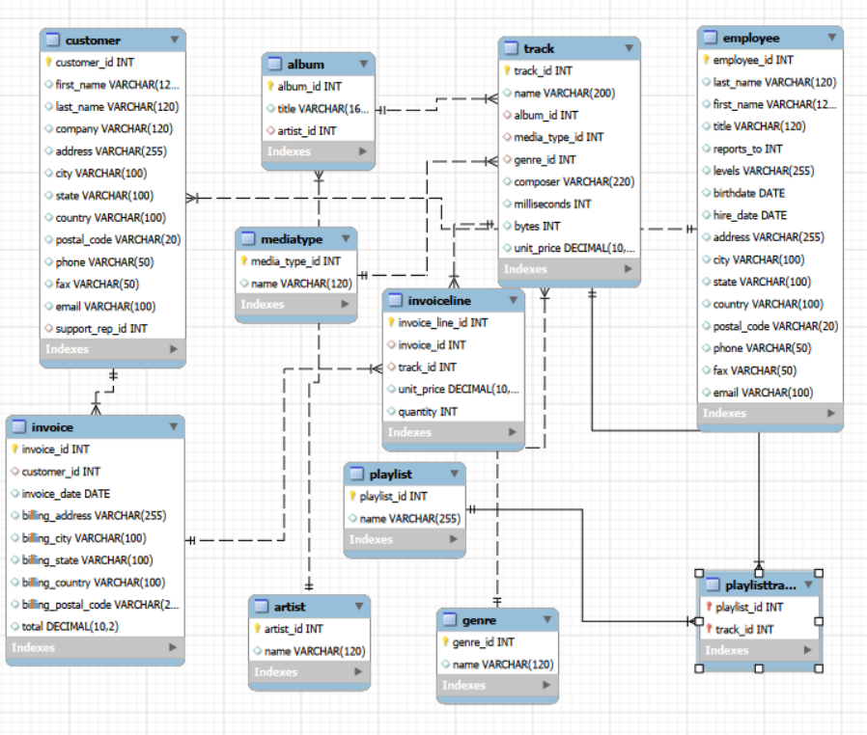
ER Diagram

Slide 11
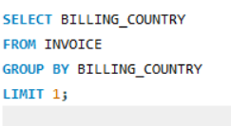
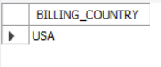
Analysis Questions
1. Which countries have the most Invoices?
OUTPUT:

Slide 12
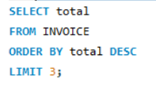
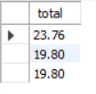
Q2.What are the top 3 values of total invoice?
OUTPUT:

Slide 13
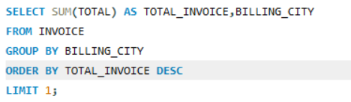
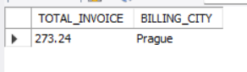
Q3. Which city has the best customers? - We would like to throw a promotional Music Festival in the city we made the most money. Write a query that returns one city that has the highest sum of invoice totals. Return both the city name & sum of all invoice totals
OUTPUT:

Slide 14
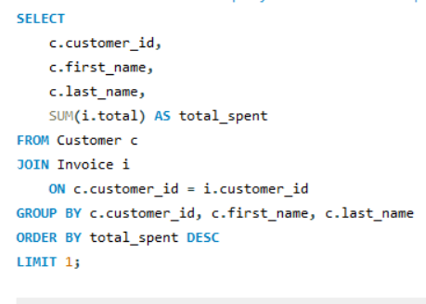
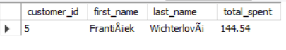
Q4.Who is the best customer? -The customer who has spent the most money will be declared the best customer. Write a query that returns the person who has spent the most money
OUTPUT:

Slide 15
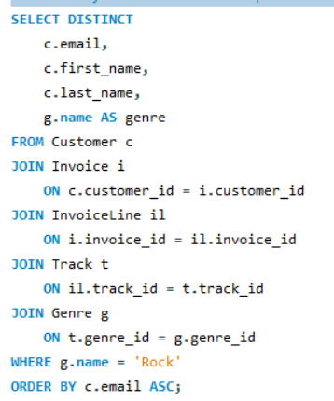
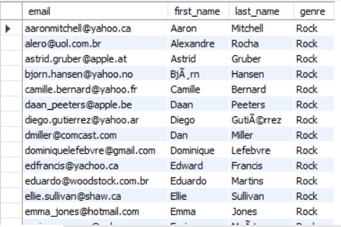
Q5.Write a query to return the email, first name, last name, & Genre of all Rock Music listeners. Return your list ordered alphabetically by email starting
OUTPUT:

Slide 16
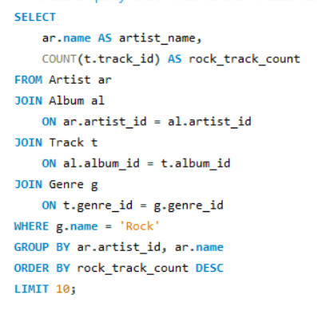
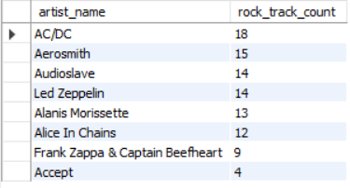
Q6.Let's invite the artists who have written the most rock music in our dataset. Write a query that returns the Artist name and total track count of the top 10 rock bands
OUTPUT:

Slide 17
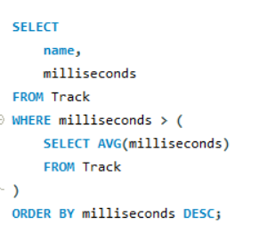
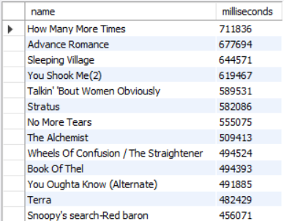
Q7.Return all the track names that have a song length longer than the average song length.-Return the Name and Milliseconds for each track. Order by the song length, with the longest songs listed first
OUTPUT:

Slide 18
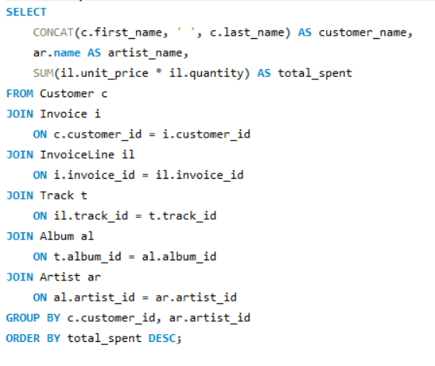
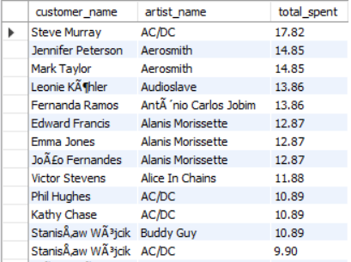
Q8.Find how much amount is spent by each customer on artists? Write a query to return customer name, artist name and total spent
OUTPUT:

Slide 19
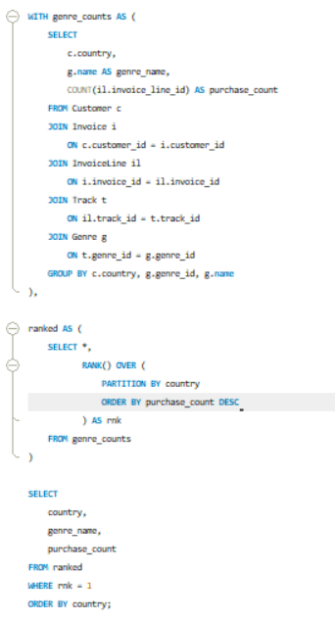
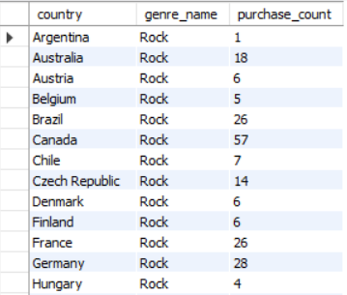
Q9.We want to find out the most popular music Genre for each country. We determine the most popular genre as the genre with the highest amount of purchases.-- Write a query that returns each country along with the top Genre. For countries where the maximum number of purchases is shared, return all Genres
OUTPUT:

Slide 20
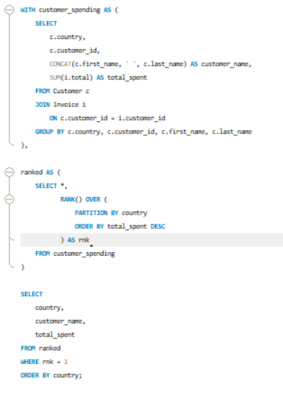
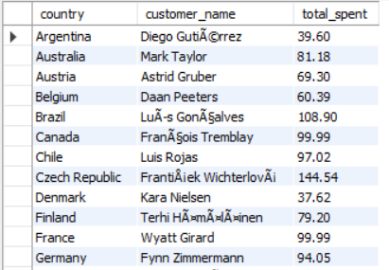
Q10.Write a query that determines the customer that has spent the most on music for each country. Write a query that returns the country along with the top customer and how much they spent. For countries where the top amount spent is shared, provide all customers who spent this amount
OUTPUT:

Slide 21
Final Business Insights & Recommendations
Key Insights:-
A small group of customers generates most of the revenue, identifying high-value loyal customers.
Rock and Pop genres along with a few top artists contribute to the majority of sales.
Certain cities and countries consistently show higher invoice totals, making them the most profitable markets.
Recommendations:-
Introduce loyalty programs and personalized offers to retain top customers.
Focus promotions and marketing on popular genres and best-selling artists.
Target high-revenue cities with special campaigns, events, and strategic investments.

Slide 22
Challenges Working on SQL Project
Understanding table relationships and writing correct multi-table JOIN queries was initially challenging.
Handling aggregations (SUM, COUNT, GROUP BY, HAVING) and complex analytical queries required careful logic building.
Ensuring data accuracy and consistency using primary keys, foreign keys, and constraints while importing large datasets.

Slide 23
Conclusion
This project demonstrates how a structured relational database and SQL queries can transform raw music store data into meaningful business insights. By analyzing customers, sales, genres, and revenue trends, we identified key growth opportunities and supported data-driven decision-making. Overall, the project strengthened practical SQL skills, analytical thinking, and real-world problem-solving abilities.

Slide 24


Slide 25

THANK YOU

